Slide 1
CSM 491 - Graph Theory and Its Application
Lectures 5
by
Dr. Oliver Kornyo
Dept. of Computer Science

Slide 2
TREES
Lecture Outline
What is A Tree?
Pendant Vertices in a Tree
Application of Trees in Programming
Distance and Centres
Binary Trees
Spanning Trees
Rank and Nullity

Slide 3
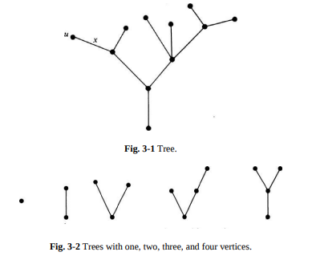
What is a Tree?
A tree is a connected graph without any circuits.
The graph in Fig. 3-1, for instance, is a tree. Trees with one, two, three, and four vertices are shown in Fig. 3-2.
A graph must have at least one vertex, and therefore so must a tree. Some authors allow the null tree, a tree without any vertices

Slide 4
SOME PROPERTIES OF TREES
There is one and only one path between every pair of vertices in a tree, T.
If in a graph G there is one and only one path between every pair of vertices, G is a tree.
A tree with n vertices has n − 1 edges.
Any connected graph with n vertices and n − 1 edges is a tree.
A graph is a tree if and only if it is minimally connected.
A graph G with n vertices, n − 1 edges, and no circuits is connected.

Slide 5

Examples of Tree and Not A Tree

Slide 6

Real examples of Tree

Slide 7

Real examples of Tree

Slide 8

Real examples of Tree

Slide 9
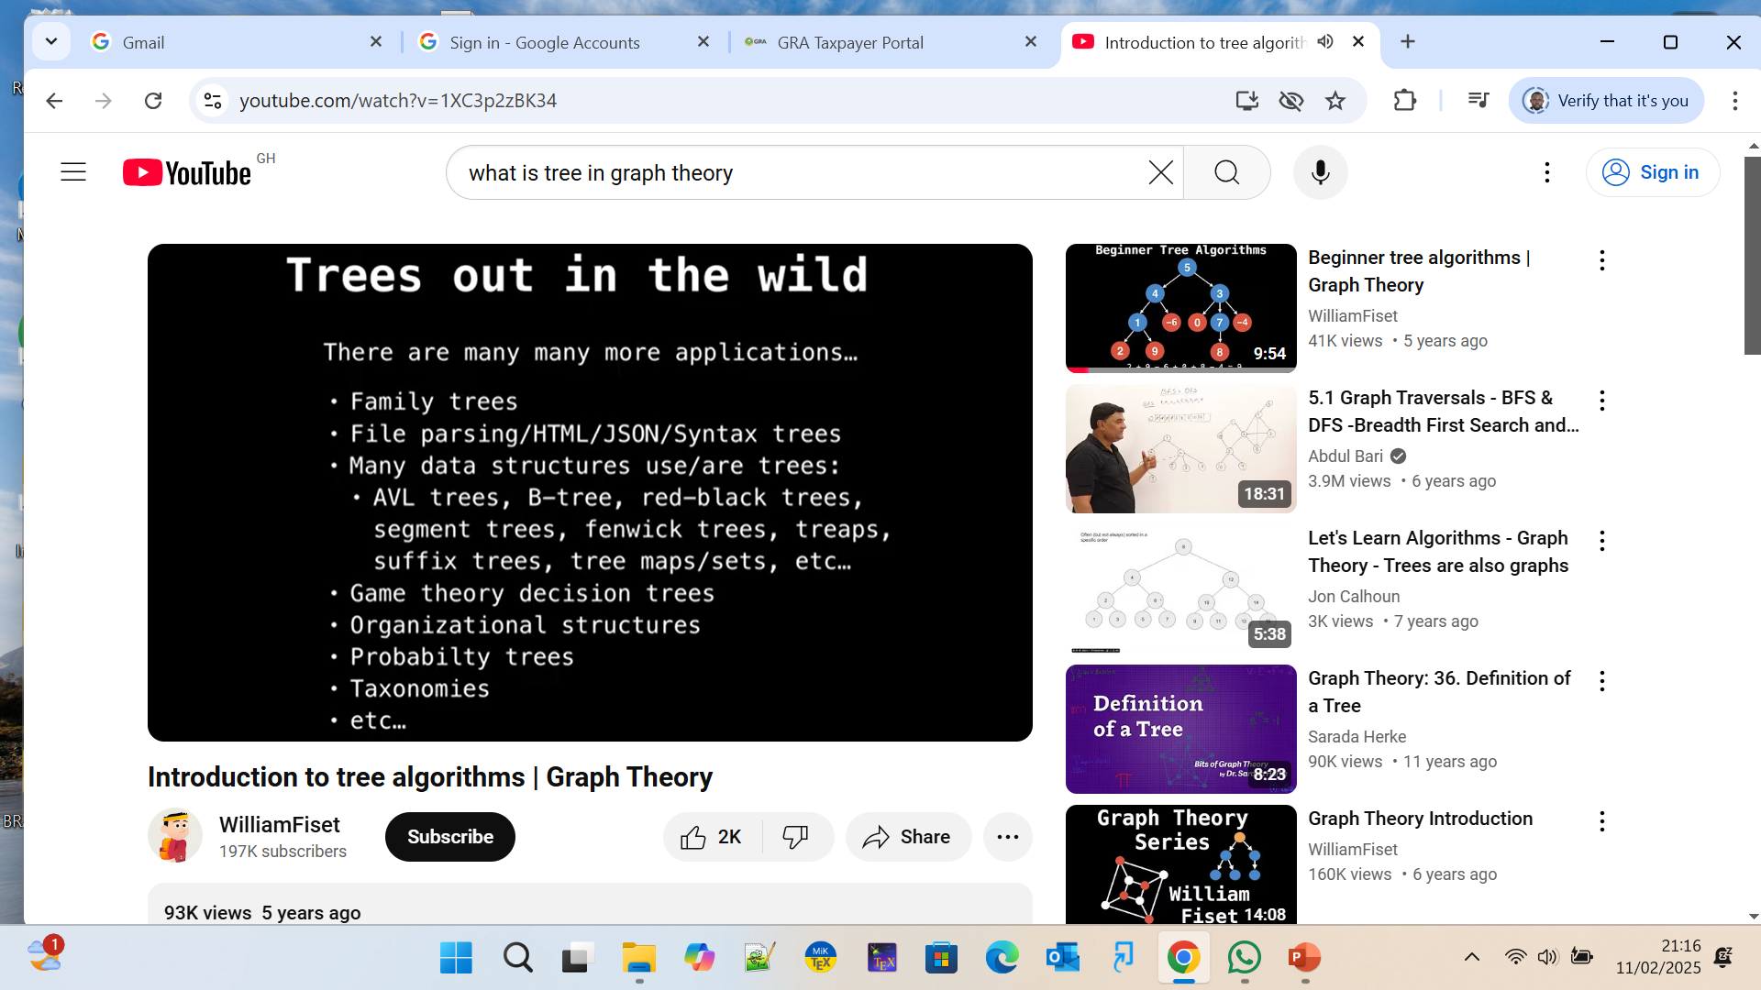
Other Area of Computer Science

Slide 10
PENDANT VERTICES IN A TREE
A pendant is defined as a vertex of degree one.
The reason is that in a tree of n vertices we have n − 1 edges, and hence 2(n − 1) degrees to be divided among n vertices. Since no vertex can be of zero degree, we must have at least two vertices of degree one in a tree. This of course makes sense only if n ≥ 2.

Slide 11
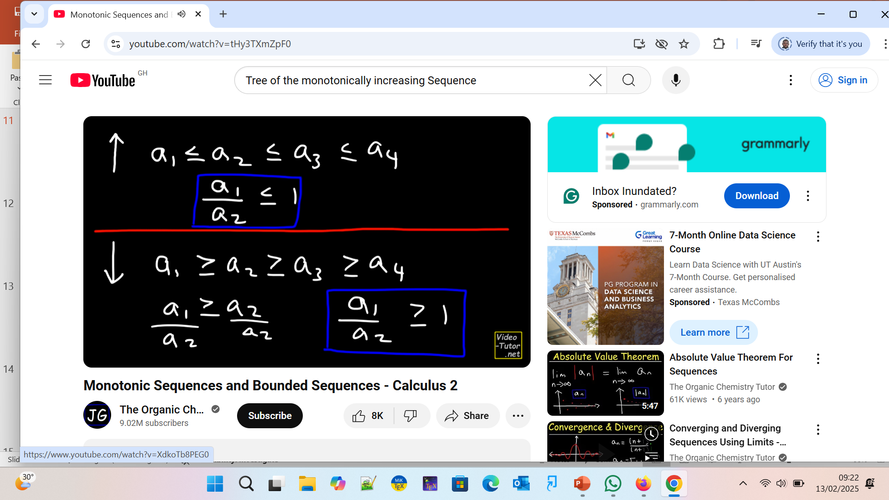
Tree of the monotonically increasing Sequence(what is Monotonic +ve or –ve sequence )

Slide 12

Example of sequence

Slide 13

Proof of sequence increasing order

Slide 14

Proof of sequence increasing order

Slide 15

Proof of sequence decreasing order

Slide 16

Proof of sequence decreasing order

Slide 17
An Application in Computer Programming
The following problem is used in teaching computer programming. Given a sequence of integers, no two of which are the same, find the largest monotonically increasing subsequence in it. Suppose that the sequence given to us is 4, 1, 13, 7, 0, 2, 8, 11, 3; it can be represented by a tree in which the vertices (except the start vertex) represent individual numbers in the sequence, and the path from the start vertex to a particular vertex v describes the monotonically increasing subsequence terminating in v.
As shown in Fig. 3-6, this sequence contains four longest monotonically increasing subsequences, that is, (4, 7, 8, 11), (1, 7, 8, 11), (1, 2, 8, 11), and (0, 2, 8, 11). Each is of length four. Such a tree used in representing data is referred to as a data tree by computer programmers.

Slide 18
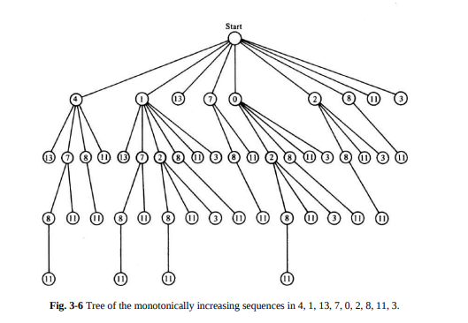
Tree of the monotonically increasing Sequence

Slide 19
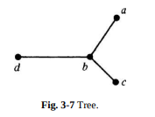
DISTANCE AND CENTERS IN A TREE
The tree in Fig. 3-7 has four vertices.
Intuitively, it seems that vertex b is located more “centrally” than any of the other three vertices.
Inherent in the concept of a center is the idea of “distance,” so we must define distance before we can talk of a center.

Slide 20
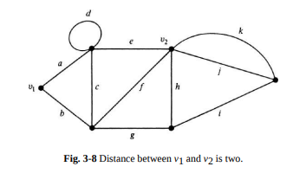
The Definition of Distance
In a connected graph G, the distance d(vi , vj ) between two of its vertices vi and vj is the length of the shortest path (i.e., the number of edges in the shortest path) between them.
For instance, some of the paths between vertices v1 and v2 in Fig. 3-8 are (a, e), (a, c, f), (b, c, e), (b, f), (b, g, h), and (b, g, i, k). There are two shortest paths, (a, e) and (b, f), each of length two. Hence d(v1 , v2 ) = 2.

Slide 21
A Metric for Distance
Before we can legitimately call a function f(x, y) of two variables a “distance” between them, this function must satisfy certain requirements. These are
Nonnegativity: f(x, y) ≥ 0, and f(x, y) = 0 if and only if x = y.
Symmetry: f(x, y) = f(x, y).
Triangle inequality: f(x, y) ≤ f(x, z) + f(z, y) for any z.
A function that satisfies these three conditions is called a metric

Slide 22
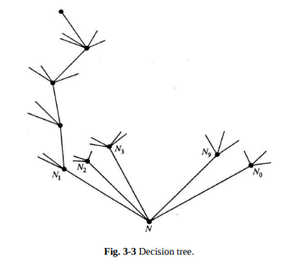
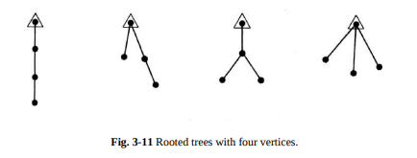
ROOTED TREES
A tree in which one vertex (called the root) is distinguished from all the others is called a rooted tree.
For instance, in Fig. 3-3 vertex N, from where all the mail goes out, is distinguished from the rest of the vertices. Hence N can be considered the root of the tree, and so the tree is rooted
Similarly, in Fig. 3-6 the start vertex may be considered as the root of the tree shown. In a diagram of a rooted tree, the root is generally marked distinctly

Slide 23
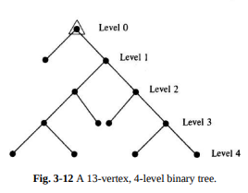
Binary Trees
A special class of rooted trees, called binary rooted trees, is of particular interest since they are extensively used in the study of computer search methods, binary identification problems, and variable-length binary codes
A binary tree is defined as a tree in which there is exactly one vertex of degree two, and each of the remaining vertices is of degree one or three (Fig. 3- 12)

Slide 24
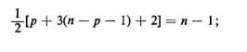
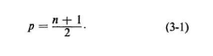
PROPERTIES OF BINARY TREES
The number of vertices n in a binary tree is always odd. This is because there is exactly one vertex of even degree, and the remaining n − 1 vertices are of odd degrees.
Let p be the number of pendant vertices in a binary tree T. Then n − p − 1 is the number of vertices of degree three. Therefore, the number of edges in T equals
Hence

Slide 25
APPLICATION OF BINARY TREES
One of the most straightforward applications of binary trees is in search procedures. Each vertex of a binary tree represents a test with two possible outcomes. We start at the root, and the outcome of the test at the root sends us to one of the two vertices at the next level, where further tests are made, and so on.
Reaching a specified pendant vertex (the goal of the search) terminates the search. For such a search procedure it is often important to construct a binary tree in which, for a given number of vertices n, the vertex farthest from the root is as close to the root as possible. Clearly, there can be only one vertex (the root) at level 0, at most two vertices at level 1, at most four vertices at level 2, and so on.

Slide 26
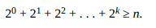
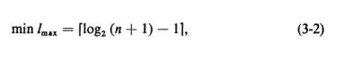
APPLICATION OF BINARY TREES (Cont’)
Therefore, the maximum number of vertices possible in a k-level binary tree is
The maximum level, lmax , of any vertex in a binary tree is called the height of the tree. It is easy to see that the minimum possible height of an n-vertex binary tree is
where [n] denotes the smallest integer greater than or equal to n.

Slide 27
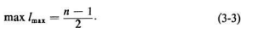
APPLICATION OF BINARY TREES (Cont’)
On the other hand, to construct a binary tree for a given n such that the farthest vertex is as far as possible from the root, we must have exactly two vertices at each level, except at the 0 level. Therefore,

Slide 28
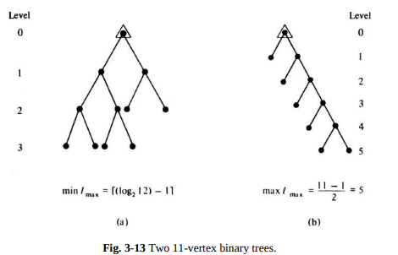
APPLICATION OF BINARY TREES (Cont’)
For n = 11, binary trees realizing both these extremes are shown in Fig. 3-13.

Slide 29
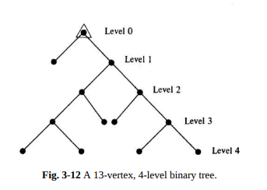
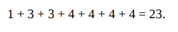
APPLICATION OF BINARY TREES (Cont’)
In analysis of algorithms we are generally interested in computing the sum of the levels of all pendant vertices. This quantity, known as the path length (or external path length) of a tree, can be defined as the sum of the path lengths from the root to all pendant vertices. The path length of the binary tree in Fig. 3- 12, for example, is

Slide 30
APPLICATION OF BINARY TREES (Cont’)
The path lengths of trees in Figs. 3-13(a) and (b) are 16 and 20, respectively. The importance of the path length of a tree lies in the fact that this quantity is often directly related to the execution time of an algorithm.
It can be shown that the type of binary tree in Fig. 3-13(a) yields the minimum path length for a given n. Weighted Path Length: In some applications, every pendant vertex vj of a binary tree has associated with it a positive real number wj .

Slide 31
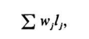
APPLICATION OF BINARY TREES (Cont’)
Given w1 , w2 , . . . , wm the problem is to construct a binary tree (with m pendant vertices) that minimizes
where l j is the level of pendant vertex vj , and the sum is taken over all pendant vertices.

Slide 32
TEST 1
A Coke machine is to identify, by a sequence of tests, the coin that is put into the machine. Only pennies, nickels, dimes, and quarters can go through the slot. Let us assume that the probabilities of a coin being a penny, a nickel, a dime, and a quarter are .05, .15, .5, and .30, respectively. Each test has the effect of partitioning the four types of coins into two complementary sets and asserting the unknown coin to be in one of the two sets. Thus for four coins we have 2 3 − 1 such tests. If the time taken for each test is the same, what sequence of tests will minimize the expected time taken by the Coke machine to identify the coin?

Slide 33
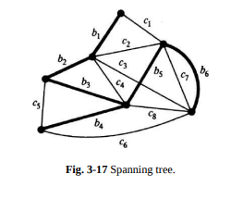
SPANNING TREES
A tree T is said to be a spanning tree of a connected graph G if T is a subgraph of G and T contains all vertices of G. For instance, the subgraph in heavy lines in Fig. 3-17 is a spanning tree of the graph shown.
Since the vertices of G are barely hanging together in a spanning tree, it is a sort of skeleton of the original graph G.
This is why a spanning tree is sometimes referred to as a skeleton or scaffolding of G. Since spanning trees are the largest (with maximum number of edges) trees among all trees in G, it is also quite appropriate to call a spanning tree a maximal tree subgraph or maximal tree of G.

Slide 34
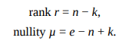
RANK AND NULLITY
When someone specifies a graph G, the first thing he is most likely to mention is n, the number of vertices in G. Immediately following comes e, the number of edges in G. Then k, the number of components G has.
From these three numbers are derived two other important numbers called rank and nullity, defined as
rank of G = number of branches in any spanning tree (or forest) of G,
nullity of G = number of chords in G,
rank + nullity = number of edges in G.
The nullity of a graph is also referred to as its cyclomatic number, or first Betti number.

Slide 35
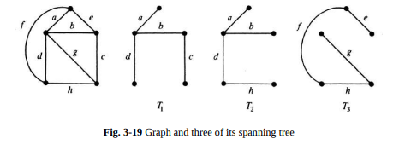
FINDING ALL SPANNING TREES OF A GRAPH
Usually, in a given connected graph there are a large number of spanning trees. In many applications we require all spanning trees. One reasonable way to generate spanning trees of a graph is to start with a given spanning tree, say tree T1 (a b c d in Fig. 3-19). Add a chord, say h, to the tree T1 .
This forms a fundamental circuit (b c h d in Fig. 3-19). Removal of any branch, say c, from the fundamental circuit b c h d just formed will create a new spanning tree T2 . This generation of one spanning tree from another, through addition of a chord and deletion of an appropriate branch, is called a cyclic interchange or elementary tree transformation

Slide 36
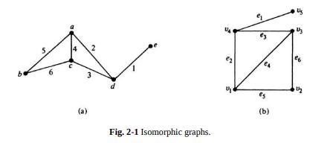
Assignment 3
Sketch all spanning trees of the graph in Fig. 2-1.
Suggest a method for determining the total number of spanning trees of a connected graph without actually listing them.
Pick 15 large cities in the Ghana and obtain the 105 intercity distances from an atlas. Find the shortest spanning tree connecting these cities by using (a) Kruskal’s method, and (b) Prim’s method. Compare their relative efficiencies.

Slide 37
THANK YOU

